Slide 1
DFS backtracking using parallel programing using mpi
By: Abdullatif Khayat and Mahmoud nashed

Slide 2
Problem
We have a matrix N * M each element inside the grid have value either one or zero now we want to calculate the sum of one’s in side matrix using more than one process using DFS + backtracking .
INPUT:
Size of row and the size of column
OUTPUT:
The sum of one’s inside matrix

Slide 3
Example:
ROW = 5
CLOUMN = 7
NOTE: our value is random value we use random method
0 | 1 | 0 | 0 | 1 | 0 | 1
1 | 0 | 0 | 0 | 0 | 0 | 1
0 | 0 | 0 | 0 | 1 | 1 | 0
0 | 0 | 0 | 0 | 0 | 0 | 1
1 | 0 | 1 | 1 | 0 | 1 | 1

Slide 4
For this example we will use three process
So every process will take two columns except the last one will take three columns because:
STEP = columns / Size_Process = 7 / 3 = 2
Rank = 2
STEP = 7 / 3 + (7%3)
= 2 + 1 = 3

Slide 5
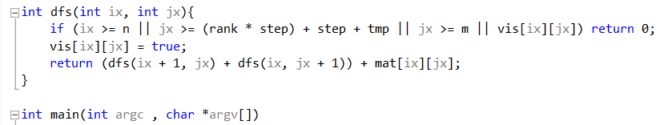
Rank0 ans = 3
0
1
0 | 1
1 | 0
0 | 0
0 | 0
1 | 0

Slide 6
Rank1 Ans = 2
2
3
0 | 0
0 | 0
0 | 0
0 | 0
1 | 1

Slide 7
Rank2 ans = 8
4
5
6
1 | 0 | 1
0 | 0 | 1
1 | 1 | 0
0 | 0 | 1
0 | 1 | 1

Slide 8
Now add all our ans in sum using mpi_Reduce
Our sum will take it’s value in MPI_REDUCE : will send ans for every process and will make sum for the operation and gathering this value in sum
So The sum of all ones in the matrix : 13

Slide 9

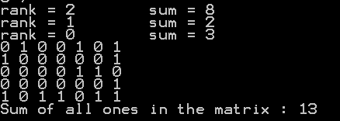
Our Process
Our input in the matrix
The result of this Problem

Slide 10
Thanks for nothing

